Slide 1

Evaluating Gam’s from the mgcv R package
Sam Kloese, acas, cspa, maaa, cpcu, dtm

Slide 2
agenda
Introduce dataset
Build GAM
Evaluate GAM

Slide 3
Dataset
Part of CASdatasets package
Actuarial Datasets
Originally for “Computational Actuarial Science with R” Book
French Motor Third-Party Liability Datasets used for Data Science Game
Using tables pg17trainpol and pg17trainclaim
Merged Data Size
100,000 rows
34 columns
16,445 claims
Columns:
Policy Coverage (pol_coverage): Mini, Median1, Median2, Maxi
Policy Usage (pol_usage): WorkPrivate, Professional, Retired, AllTrips
Driver Age 1 (drv_age1): Driver age of the first driver
Vehicle Age (vh_age): Difference between current year and release year
Vehicle DIN (vh_din): Metric Horse Power (13-200)
Vehicle Weight (vh_weight): Measured in kilograms (0-7,901)

Slide 4
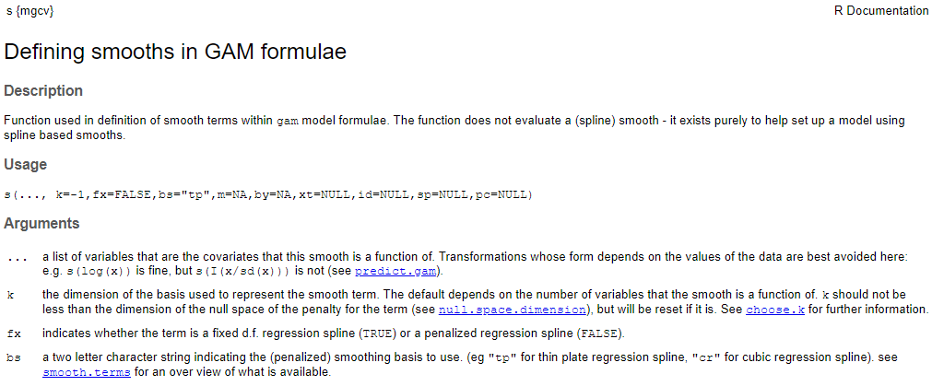
Single Variable smooths
Columns to smooth are wrapped in “s( )”
The smooth type is controlled by the bs argument
The default smooth type is thin plate (bs = “tp”)
The argument k determines the number of basis functions

Slide 5
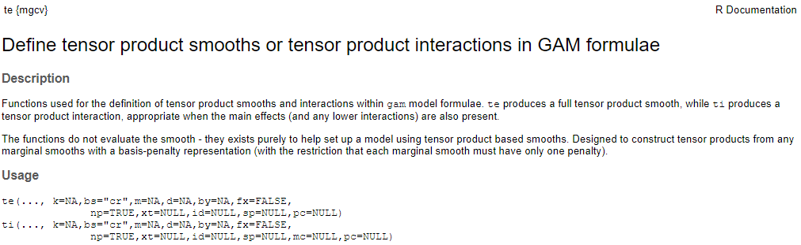
Tensor interaction smooths
Tensor smooths are useful when the 2 variables have different scales
te() produces a full tensor product smooth
Use when the variables do not have their own terms
ti() produces a tensor product interaction
Use when the main effects are already in the model
Experimenting with motor power and vehicle weight
Vehicle DIN: 13-200 Metric Horse Power
Vehicle Weight : 0-7901 kilograms

Slide 6
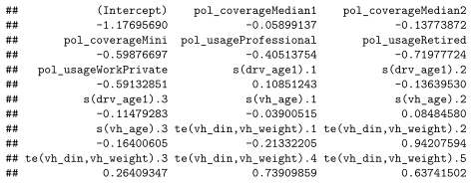

Tensor Interaction smooth
Two non-smoothed terms
Policy Coverage
Policy Usage
Two smoothed main effect terms
Driver Age 1
Vehicle Age
One smoothed interaction term
Vehicle DIN & Vehicle weight

Slide 7
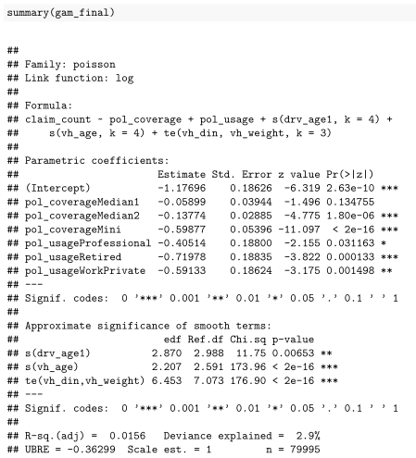
Summary() on the Model Object
Two non-smoothed terms
Policy Coverage
Policy Usage
Two smoothed main effect terms
Driver Age 1
Vehicle Age
One smoothed interaction term
Vehicle DIN & Vehicle weight

Slide 8
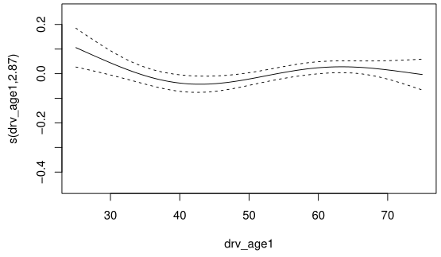
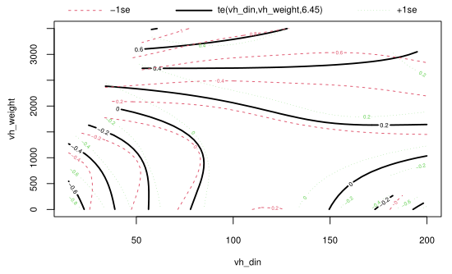
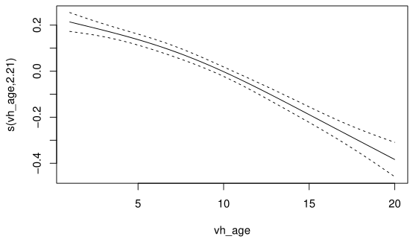
Default plot smooths

Slide 9


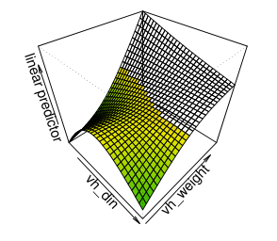
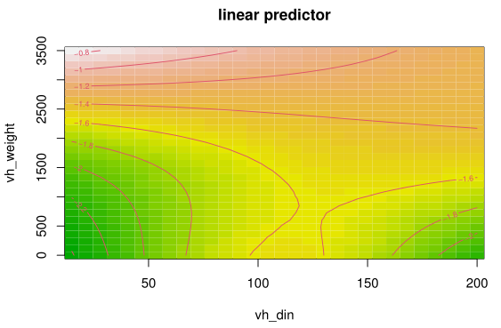
Visualize interaction

Slide 10
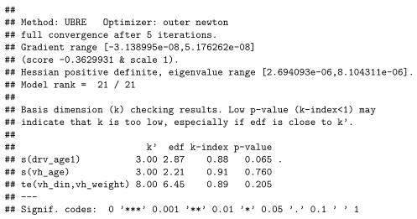
Gam.check() Automated results
We want HIGH values for these p-values
We are checking if one of the smooths is predictive of the residuals
We sure hope it isn’t!
We want higher k-index values

Slide 11
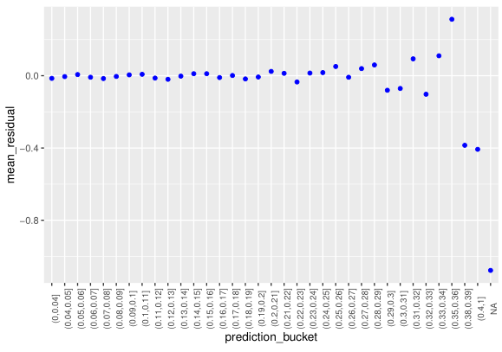
Average residual by predicted value
Residual = actual frequency – predicted frequency
Blue dots are the average residual
X-axis is 1% intervals of predicted values
We want to see mean residuals near 0 across low and high predictions

Slide 12
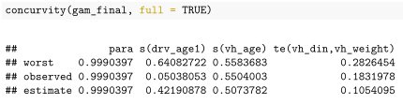
Concurvity() on the model object
GLM’s can suffer from collinearity
GAM’s can suffer from both collinearity AND concurvity
Worst, observed, estimate are different measurements of concurvity
Worst is the most pessimistic
Rule of thumb:
Worst case concurvity > 0.8 is too much

Slide 13
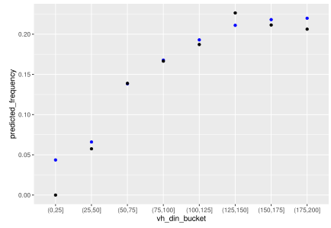
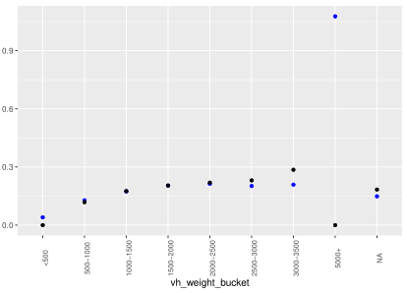
Actual vs. Expected plots
Blue – Predicted Frequency
Black – Actual Frequency

Slide 14
Iterative AIC
Model | AIC
~Policy Coverage | 75,753
~Policy Coverage + Policy Usage | 75,422
~Policy Coverage + Policy Usage + s(Driver Age) | 75,406
~Policy Coverage + Policy Usage + s(Driver Age) + s(Vehicle Age) | 75,118
~Policy Coverage + Policy Usage + s(Driver Age) + s(Vehicle Age) + te(Vehicle Din, Vehicle Weight) | 74,955
Residual Deviance is a goodness of fit statistic
Lower numbers are better
Adding new terms to a model ALWAYS lowers residual deviance
AIC is a penalized measure of deviance
Deals with the trade-off between goodness of fit and model simplicity
Adding new terms to a model may lower AIC
Increasing AIC may be a sign that the term added may not be contributing significantly

Slide 15
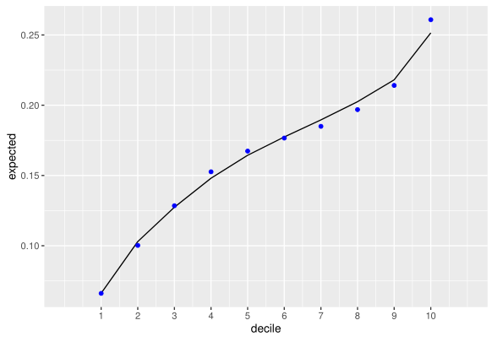
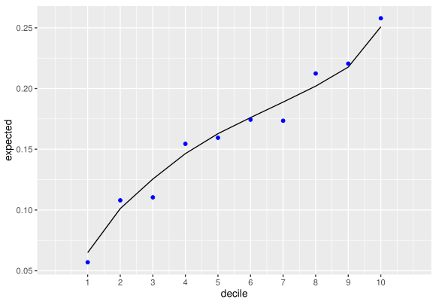
Holdout test
TRAINING
Holdout Test
80% of clients in Training
20% of clients in Testing
Building Decile Plots
Sort based on predictions
Group into 10 equally sized deciles
Plot actual frequency and expected frequency
Evaluating Decile Plots
Lift
Predictive Accuracy
Monotonicity
TESTING

Slide 16
Code available on github
KloeseCode/GAM_Examples: Example Code for Generalized Additive Models (github.com)

